Slide 1
Air Masses & Fronts

Slide 2
Air Masses & Fronts: Outline
Air Masses & Source Regions
Fronts: 4 types
Cold Fronts
Warm Fronts
Stationary Fronts
Occluded Fronts
Drylines

Slide 3
Air Masses & Source Regions
Air Mass:
Large body of air (approx. 1000 miles across) having little horizontal variation in temperature & moisture at any given level.
Source Region:
A large area of land or ocean of more-or-less uniform characteristics, above which an air mass can form
A relatively uniform surface area can produce a relatively uniform mass of air above it.

Slide 4
Air Masses & Source Regions
Source Regions
Latitude & Temperature. Air Masses that originate in:
Very High latitudes are called Arctic (A)
High latitudes are called Polar (P)
Low latitudes are called Tropical (T)
Continental (c)
Continents tend to produce air of low humidity
Maritime (m)
Oceans tend to produce air of high humidity

Slide 5
Air Masses & Source Regions
Five Basic Air Masses:
continental arctic (cA)
continental polar (cP)
continental tropical (cT)
maritime polar (mP)
maritime tropical (mT)
Note: maritime arctic air masses do not exist. Water will freeze at these extremely cold temperatures

Slide 6
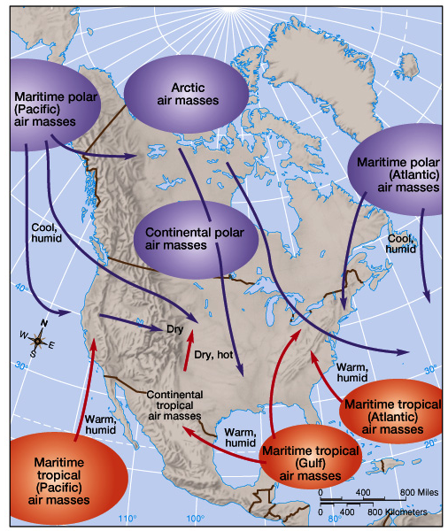
Fig. 9-1 (p. 257) shows source regions for North America
7 air source regions are shown.
These can be simplified into the 5 types outlined previously

Slide 7
Air Masses & Source Regions
CONTINENTAL POLAR (cP)
Form over large high latitude land masses
In winter, lose more radiant energy than received from sun
very cool, dry and stable – no clouds.
Because air is cooled by the surface, temperature inversion is created, enhancing stability
In summer, similar but less extreme.

Slide 8
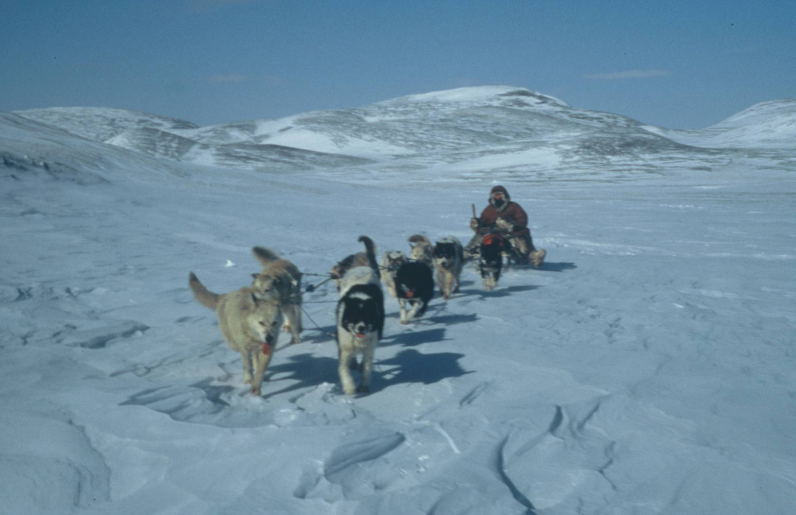
Dog Sled Team in Siberia: One Source Region For cP

Slide 9
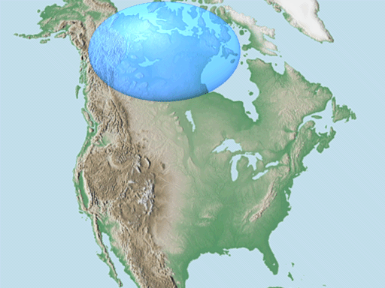

Slide 10
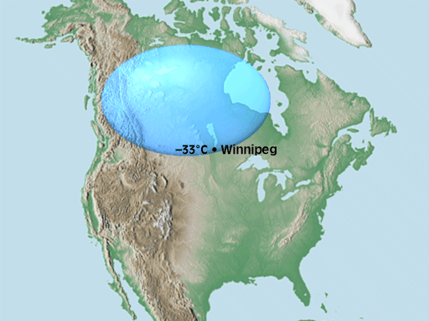

Slide 11
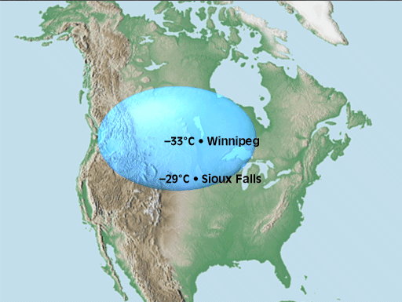

Slide 12
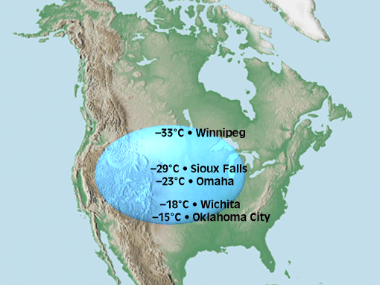

Slide 13
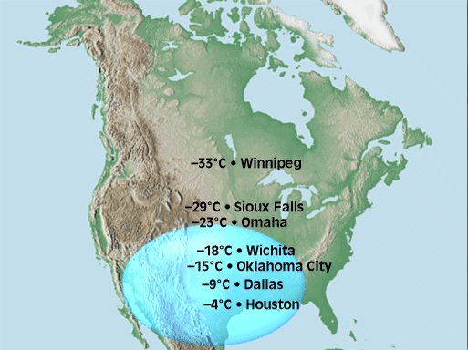

Slide 14
Air Masses & Source Regions
CONTINENTAL ARCTIC (cA)
Similar to polar air
Very cold, very dry
But more extreme because air forms behind the POLAR Front

Slide 15
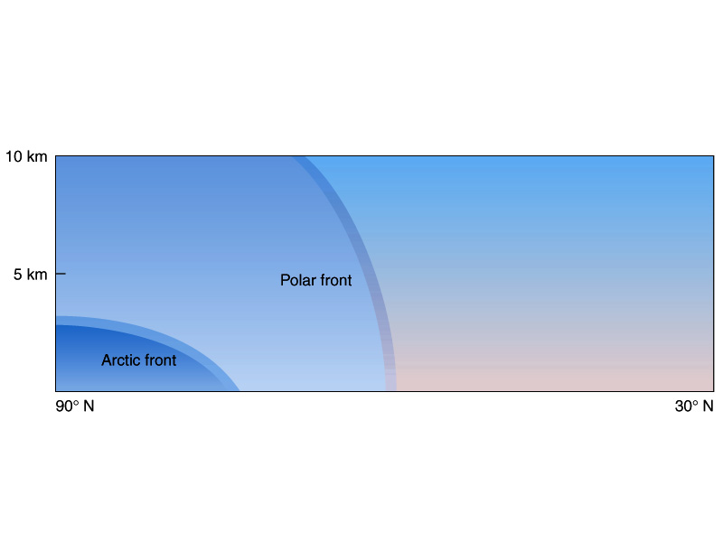
Fig. 9-2 (p. 258)

Slide 16
Air Masses & Source Regions
MARITIME POLAR (mP)
Similar to cP but warmer and wetter.
Forms over north Pacific, warmer water.
Also forms over north Atlantic, where most pronounced as ‘nor’easters’ (cold winds, heavy snowfall) after passage of a cyclone

Slide 17
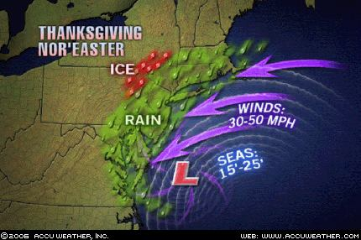
Nor’ Easters Draw mP ahsore from the N. Atlantic

Slide 18
Air Masses & Source Regions
CONTINENTAL TROPICAL (cT)
Forms over hot, low latitude areas (SW USA, N Mexico)
Very warm and dry
Little moisture available for evaporation
No clouds
Very unstable because its so hot

Slide 19
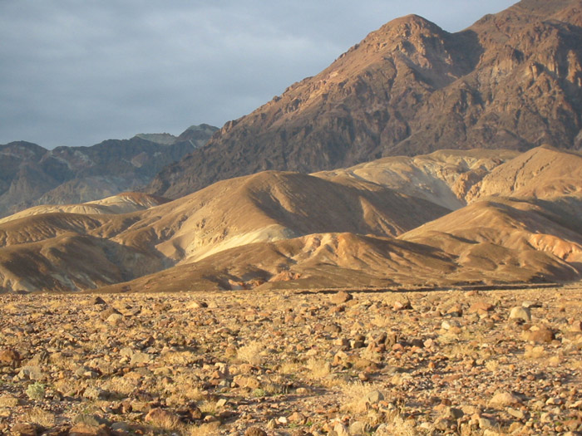
SW USA & N Mexico are a source region for cT

Slide 20
Air Masses & Source Regions
MARITIME TROPICAL (mT)
Form over warm tropical oceans
Warm and very moist
Unstable
Many clouds,
Precipitation likely as they move over (hot) land and lift further
Most influential from Gulf of Mexico and Atlantic – but also Pacific on far west coast

Slide 21
Cold
Cold air moves into warm
Warm
Warm air moves into cold
Stationary
Air masses touching but not moving
Occluded
Warm air is lifted completely off the ground.
May be cold or warm…
Fig 9-4 (p. 265)

Slide 22
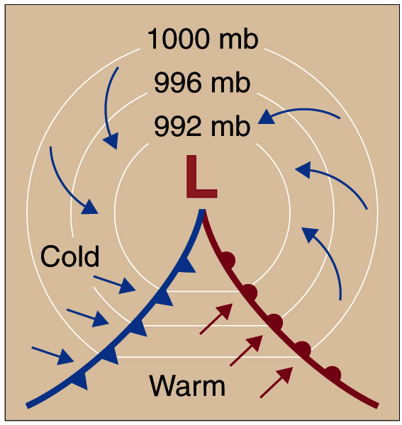
Both Warm & Cold Fronts rotate about Mid-Latitude Cyclones
Fig 9-5 (p. 265)

Slide 23
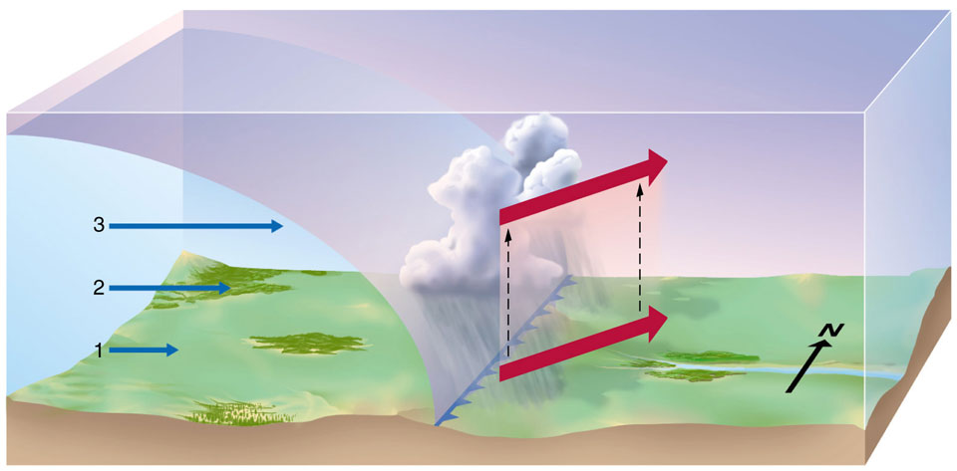
Heavy Rainfall in horizontally narrow bands
Rapid Temp Drop; Higher Pressure; Winds W, NW or N; Rapid decrease in RH; good visibility
Higher Temps; Winds S, SW or W

Slide 25
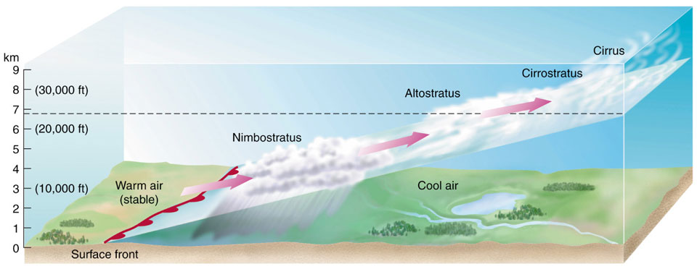
Light Rain, Snow or Drizzle, potentially lasting for several days
Higher temps; steady Pressure; winds S or SE; RH increases;
Decreasing Air Pressure; Winds S or SW

Slide 27
I’
I
I – I’ > 0 Equals Temperature Inversion. Implications for pollution…

Slide 28
Stationary Fronts
Boundary is not moving, has stalled.
Cold or Warm front boundaries LOOK and BEHAVE the same way, but for a time are stationary.
Could be moving very slowly…

Slide 29
Occluded Fronts
Occlusion, refers to closure, the end
Associated with a cyclone that has both warm and cold fronts…
Warm air is lifted off (cut-off from) the ground
Several different methods of formation

Slide 30
Both Warm & Cold Fronts rotate about Mid-Latitude Cyclones
Fig 9-5 (p. 265)

Slide 31
Cold fronts move faster than warm fronts
So cold front ‘catches up’ with the warm front
Fig. 9-10a (p. 270)

Slide 32
At the surface, two masses of cold air merge, thus surface temps are similar upon both sides of the occlusion. Warm air is forced aloft!
Fig. 9-10b (p. 270)

Slide 33
As the cold front continues to overtake the warm front, the occlusion grows longer.
This continues until the entire system is occluded.
Fig. 9-10b (p. 270)

Slide 35
Occluded Fronts
The previous examples describe the traditional (and a commonly occurring) ‘Cold Front’ Occlusion mechanism
However, Occluded Fronts can also form by other means…

Slide 36
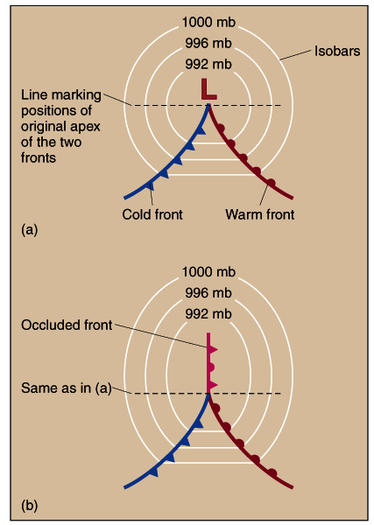
The junction of a cold and warm front will occur at the center of a Mid-Latitude cyclone.
An occlusion can form as the form of this cyclone elongates and the center moves away from the junction
Fig. 9-11 (p. 271)

Slide 37
Sometimes a cold front will move in an eastward direction in relation to the warm front.
It ‘scrapes’ its way along the warm front, leaving the occlusion in its wake.
Fig. 9-12 (p. 271)

Slide 38
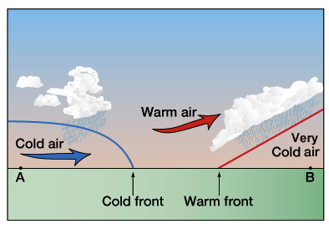
‘Warm Front’ occlusions occur in the same manner as the traditional ‘Cold Front’ occlusion
However, the air behind the cold front is less cold than that ahead of the warm front.

Slide 39
Drylines
A boundary between HUMID air and DRY air…
Vapor Molecules H₂O are lighter than Oxygen and Nitrogen O₂ and N₂
Therefore, Dry air is more dense than Humid Air at same Temperature and P (Seems counter-intuitive but we are talking about vapor not liquid)
Behaves like a cold front, with similar severe weather results

Slide 40
